Slide 1









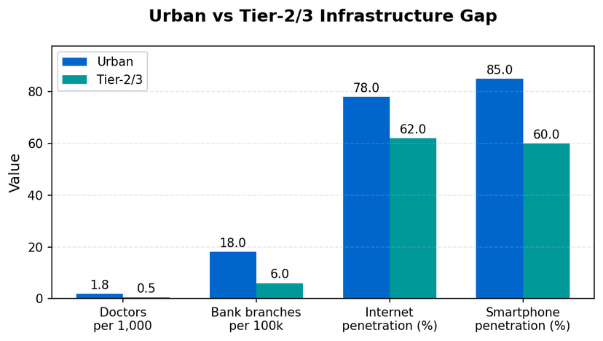
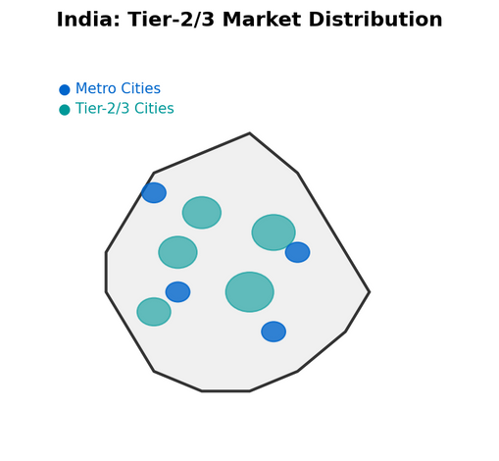
Why Tier-2 & Tier-3 India are Ripe for Disruption ?
India's Tier-2 and Tier-3 cities are no longer peripheral — they are fast becoming the engines of economic growth. With rising digital penetration and UPI-led inclusion, these markets are digitally ready yet structurally underserved, creating fertile ground for technology-led disruption.
MEDICHAIN
Economic Power
Population Scale
Digital Adoption
Payment Revolution
Tier-2/3 cities contribute ~45% of India's GDP by 2025
650M people across Tier-2/3 markets
60% smartphone penetration vs 78% urban
UPI >12B transactions/month by 2025
DISRUPTIVE, SCALABLE HEALTHCARE FOR BHARAT.
Macro Trends
🏥
Healthcare: 600M underserved; 50+ km avg travel
📚
Education: Teacher-student ratio 1:60 vs 1:30 norm
Digital Readiness + Structural gaps = Fertile ground for Disruption
🏦
Finance: 190M unbanked; <5% insured
🌾
Agriculture: Post-harvest losses ~₹90,000 Cr annually
UNDERSERVED SECTORS
Urban vs Tier -2/3 Cities Infrastructure Gap
India : Tier 2/3 Market Distribution

Slide 2


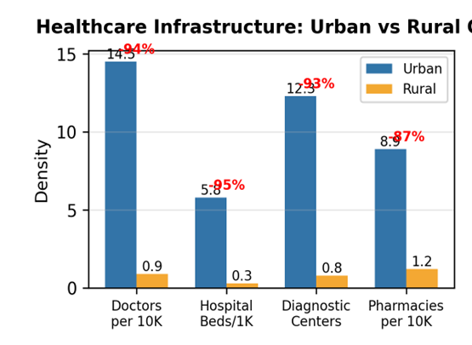
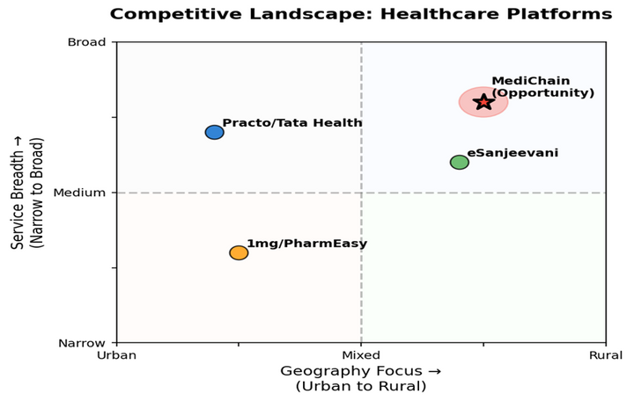
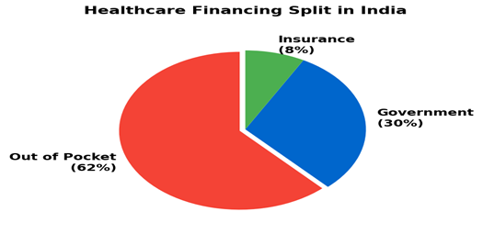
Healthcare in Tier-2/3 India: Urgent Problem, Large Market
🏥 Accessibility
💰 Affordability
🤝 Awareness & Trust
• 75% doctors urban → 600M underserved
• 50+ km avg travel
• OOP = 62% of spend
• 60M fall into poverty yearly
• Preventive stigma
• Reliance on unqualified practitioners
📈 MARKET POTENTIAL
Healthcare market
USD 372B by 2025 • CAGR ~22%
Telemedicine
USD 5.4B by 2025 • Growing rapidly
Healthcare = burning platform → unmet need + adoption proof + policy push
Diagnostics
CAGR ~20% • High demand
eSanjeevani
160M+ teleconsults • Proof of adoption
Healthcare Financing Split in India
Healthcare Infrastructure
Competitive Landscape : Healthcare Platforms

Slide 3
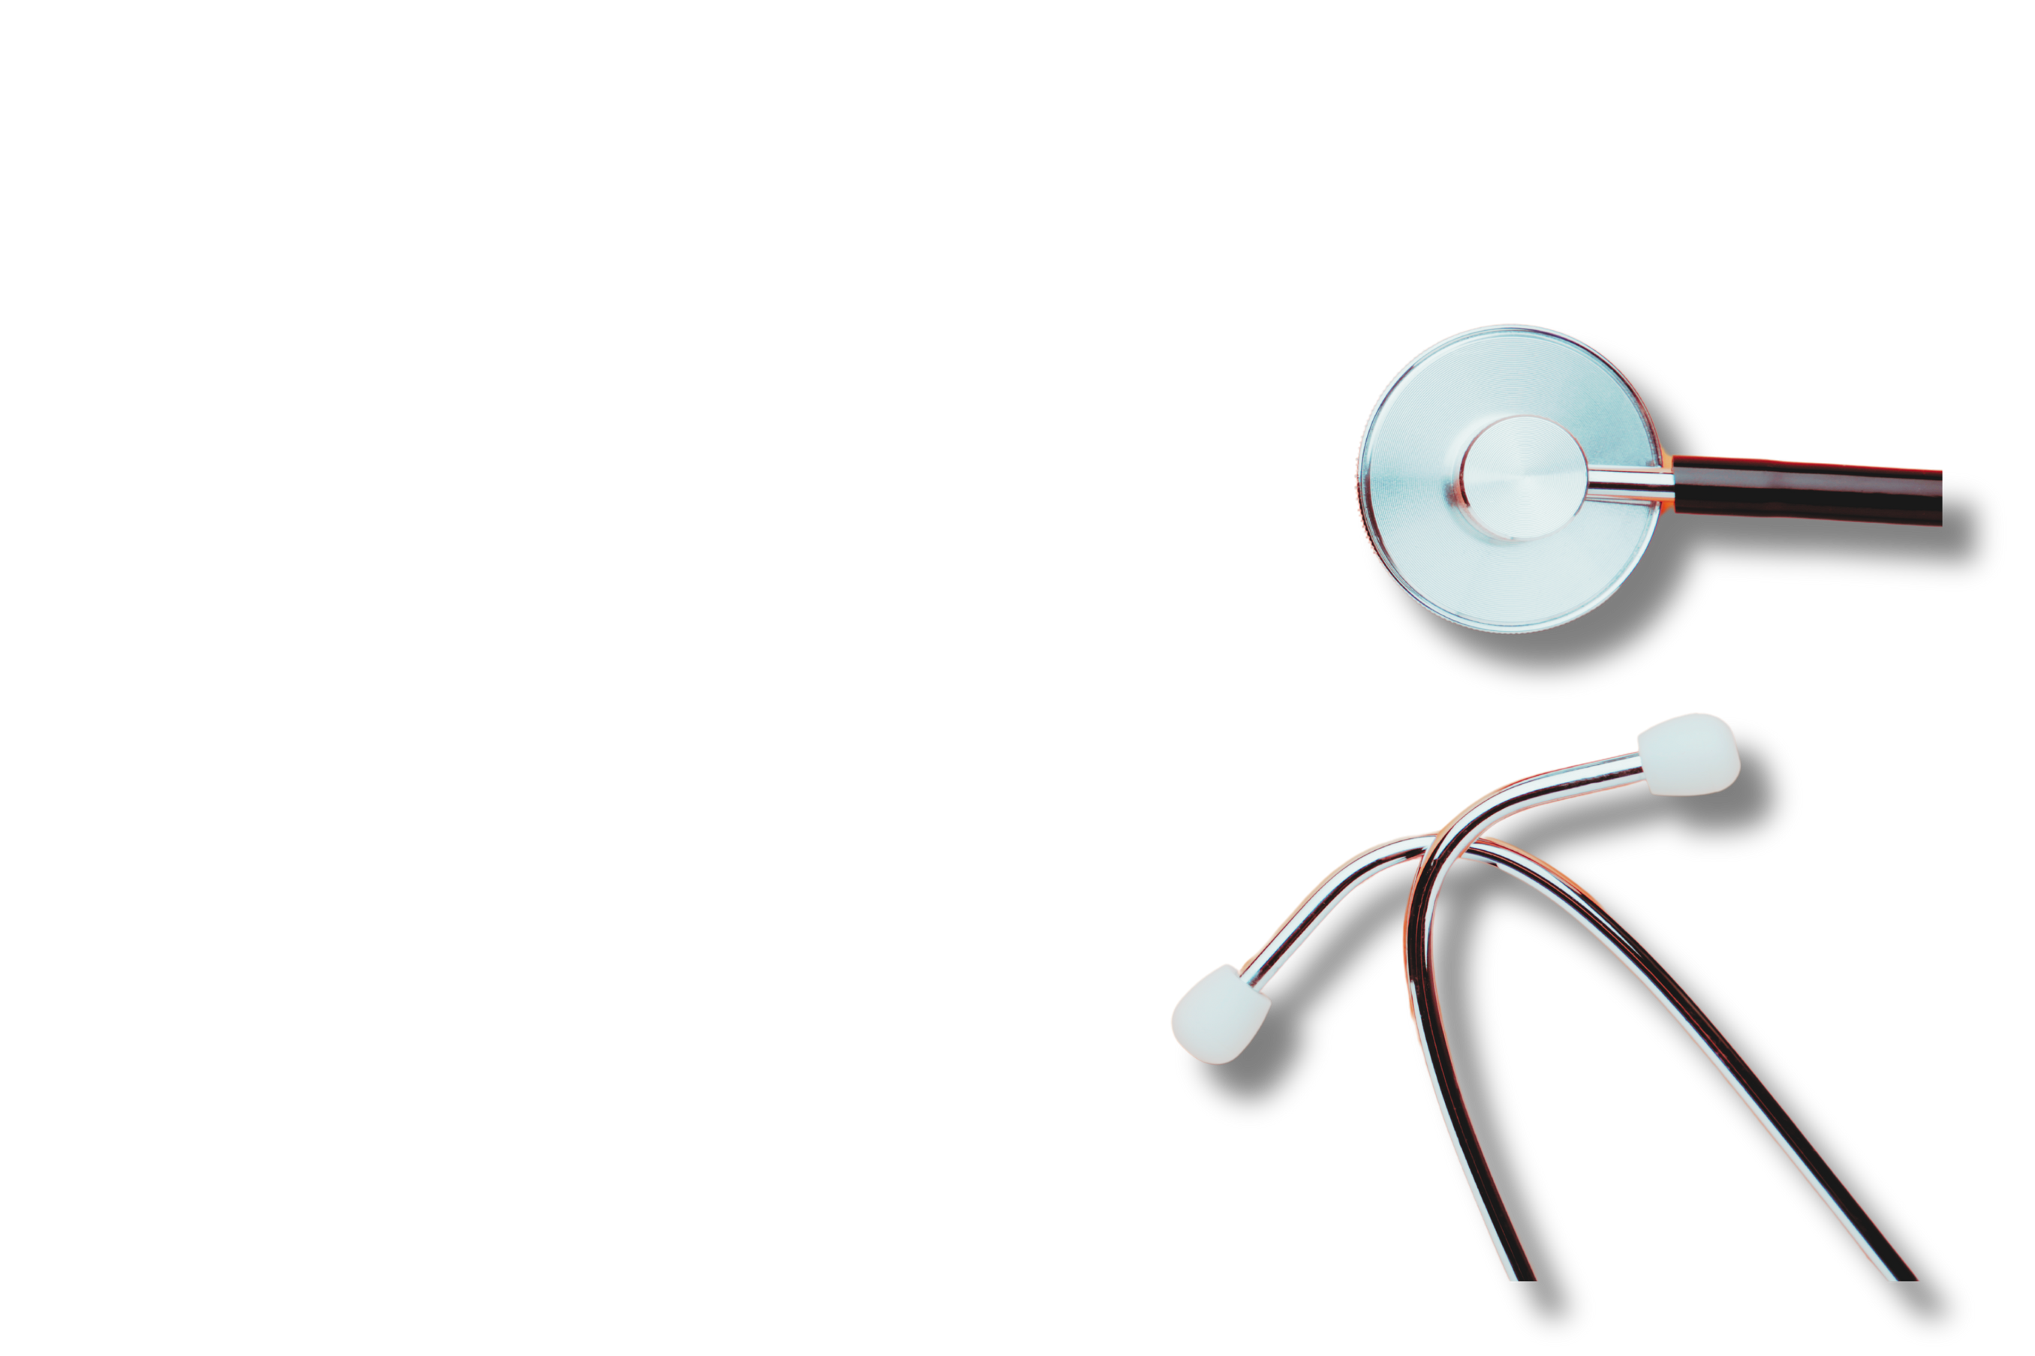
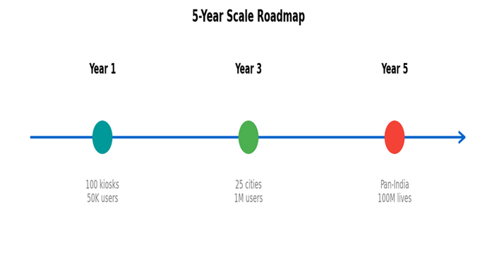


MediChain — Tech-enabled Primary Care & Diagnostics
🤖
🔬
🔗
💊
AI Symptom Triage
Vernacular chatbot
Triage <₹20
IoT Diagnostic Kiosks
BP, sugar, ECG, SPO₂
Cost ~₹1L per kiosk
Blockchain Health Records
NDHM aligned
Secure, portable
Phygital Linkages
Local pharmacies
Last-mile medicine
⭐ KEY DIFFERENTIATORS
🗣️ Vernacular-first UX for regional adoption
💰 Affordable: <₹100 consults, ₹499/year family plan
🤝 Trust: Kiosk placement in pharmacies + NGO/state tie-ups
Economic Impact:
• Low OOP burden for families
• Scalable subscription revenue
• Job creation in rural areas
Social Impact:
• Access for 100M+ underserved
• Preventive care culture
• SDG-3 alignment
Thankyou - Presented By — Nakul Nandanwar, Vaishnavi Bhangale, Rahul Kumbhare (SIMSREE)

